Slide 1



Maven Market Analysis Report
View in Power BI
Last data refresh:
3/19/2021 4:46:38 PM Romance Standard Time
Downloaded at:
3/19/2021 4:57:59 PM Romance Standard Time

Slide 2
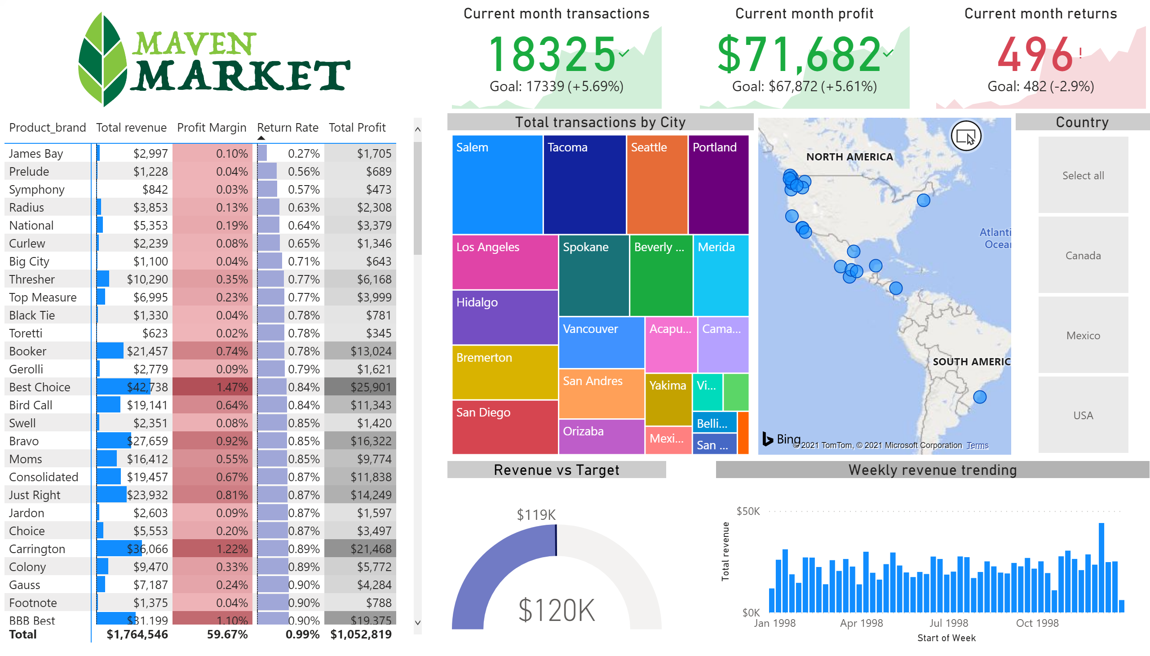
Topline performance
Notes:
image
No alt text provided.
pivotTable
No alt text provided.
Current month transactions
No alt text provided.
Current month profit
No alt text provided.
Current month returns
No alt text provided.
treemap
No alt text provided.
Weekly revenue trending
No alt text provided.
Revenue vs Target
No alt text provided.
Country
No alt text provided.
map
No alt text provided.

Slide 3
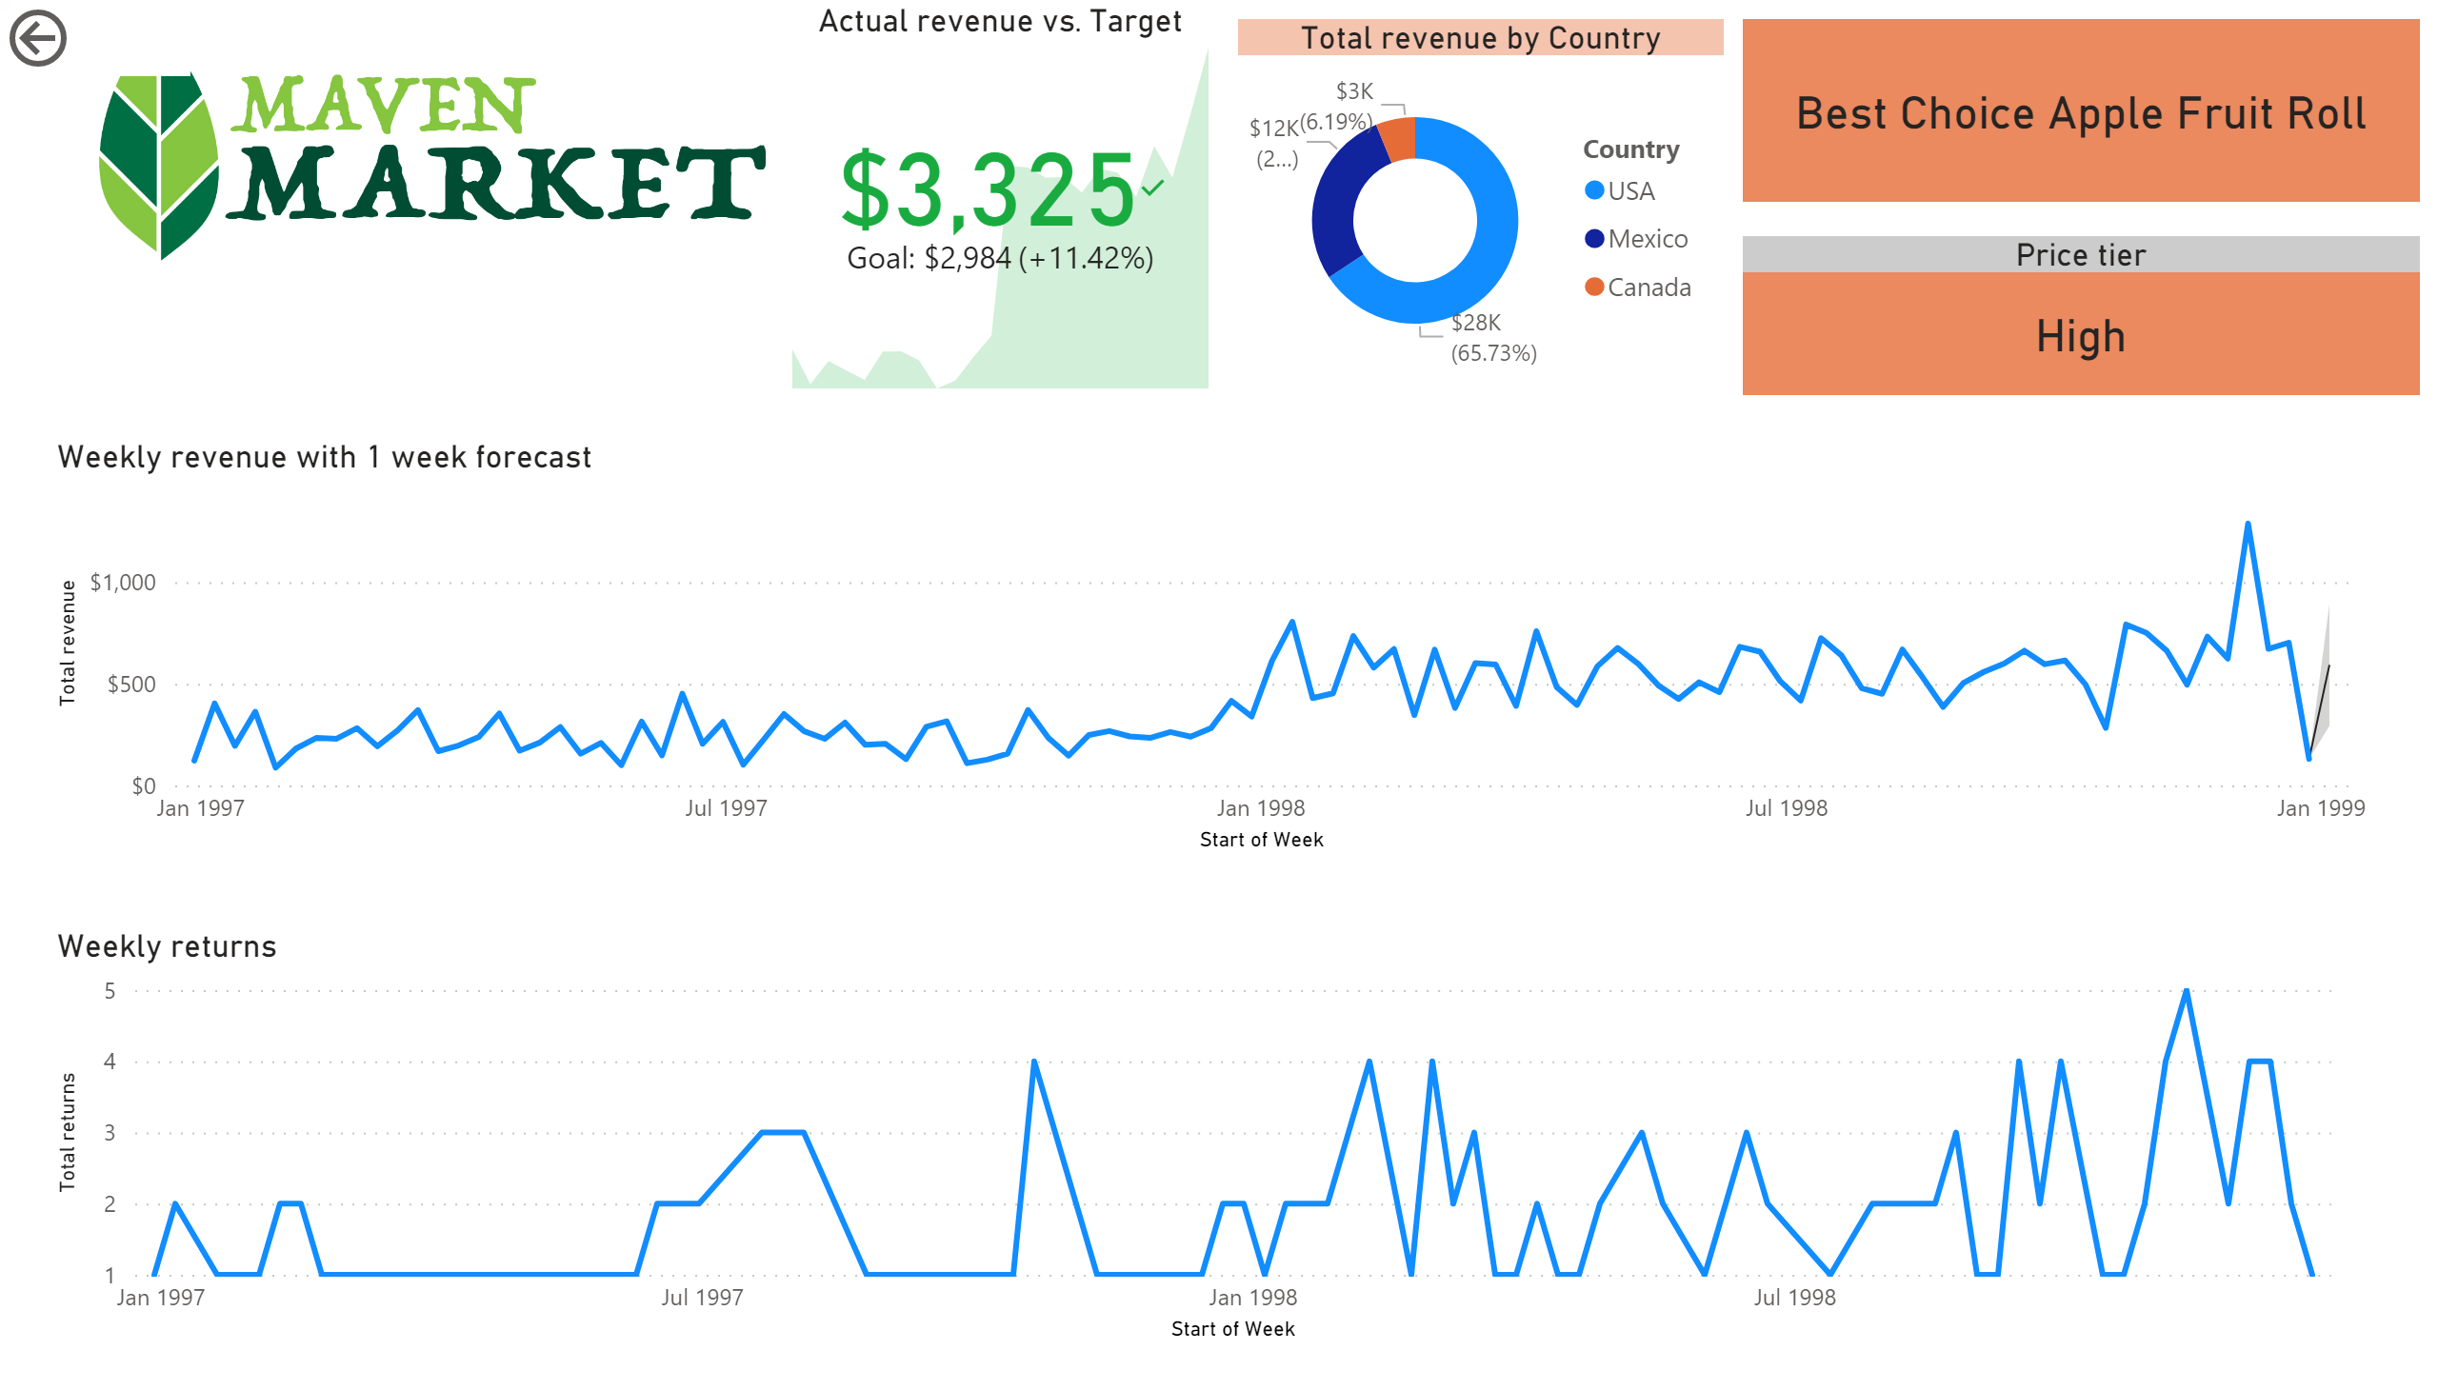
Product details
Notes:
Weekly returns
No alt text provided.
Weekly revenue with 1 week forecast
No alt text provided.
Actual revenue vs. Target
No alt text provided.
image
No alt text provided.
actionButton
No alt text provided.
card
No alt text provided.
Price tier
No alt text provided.
donutChart
No alt text provided.

Slide 4
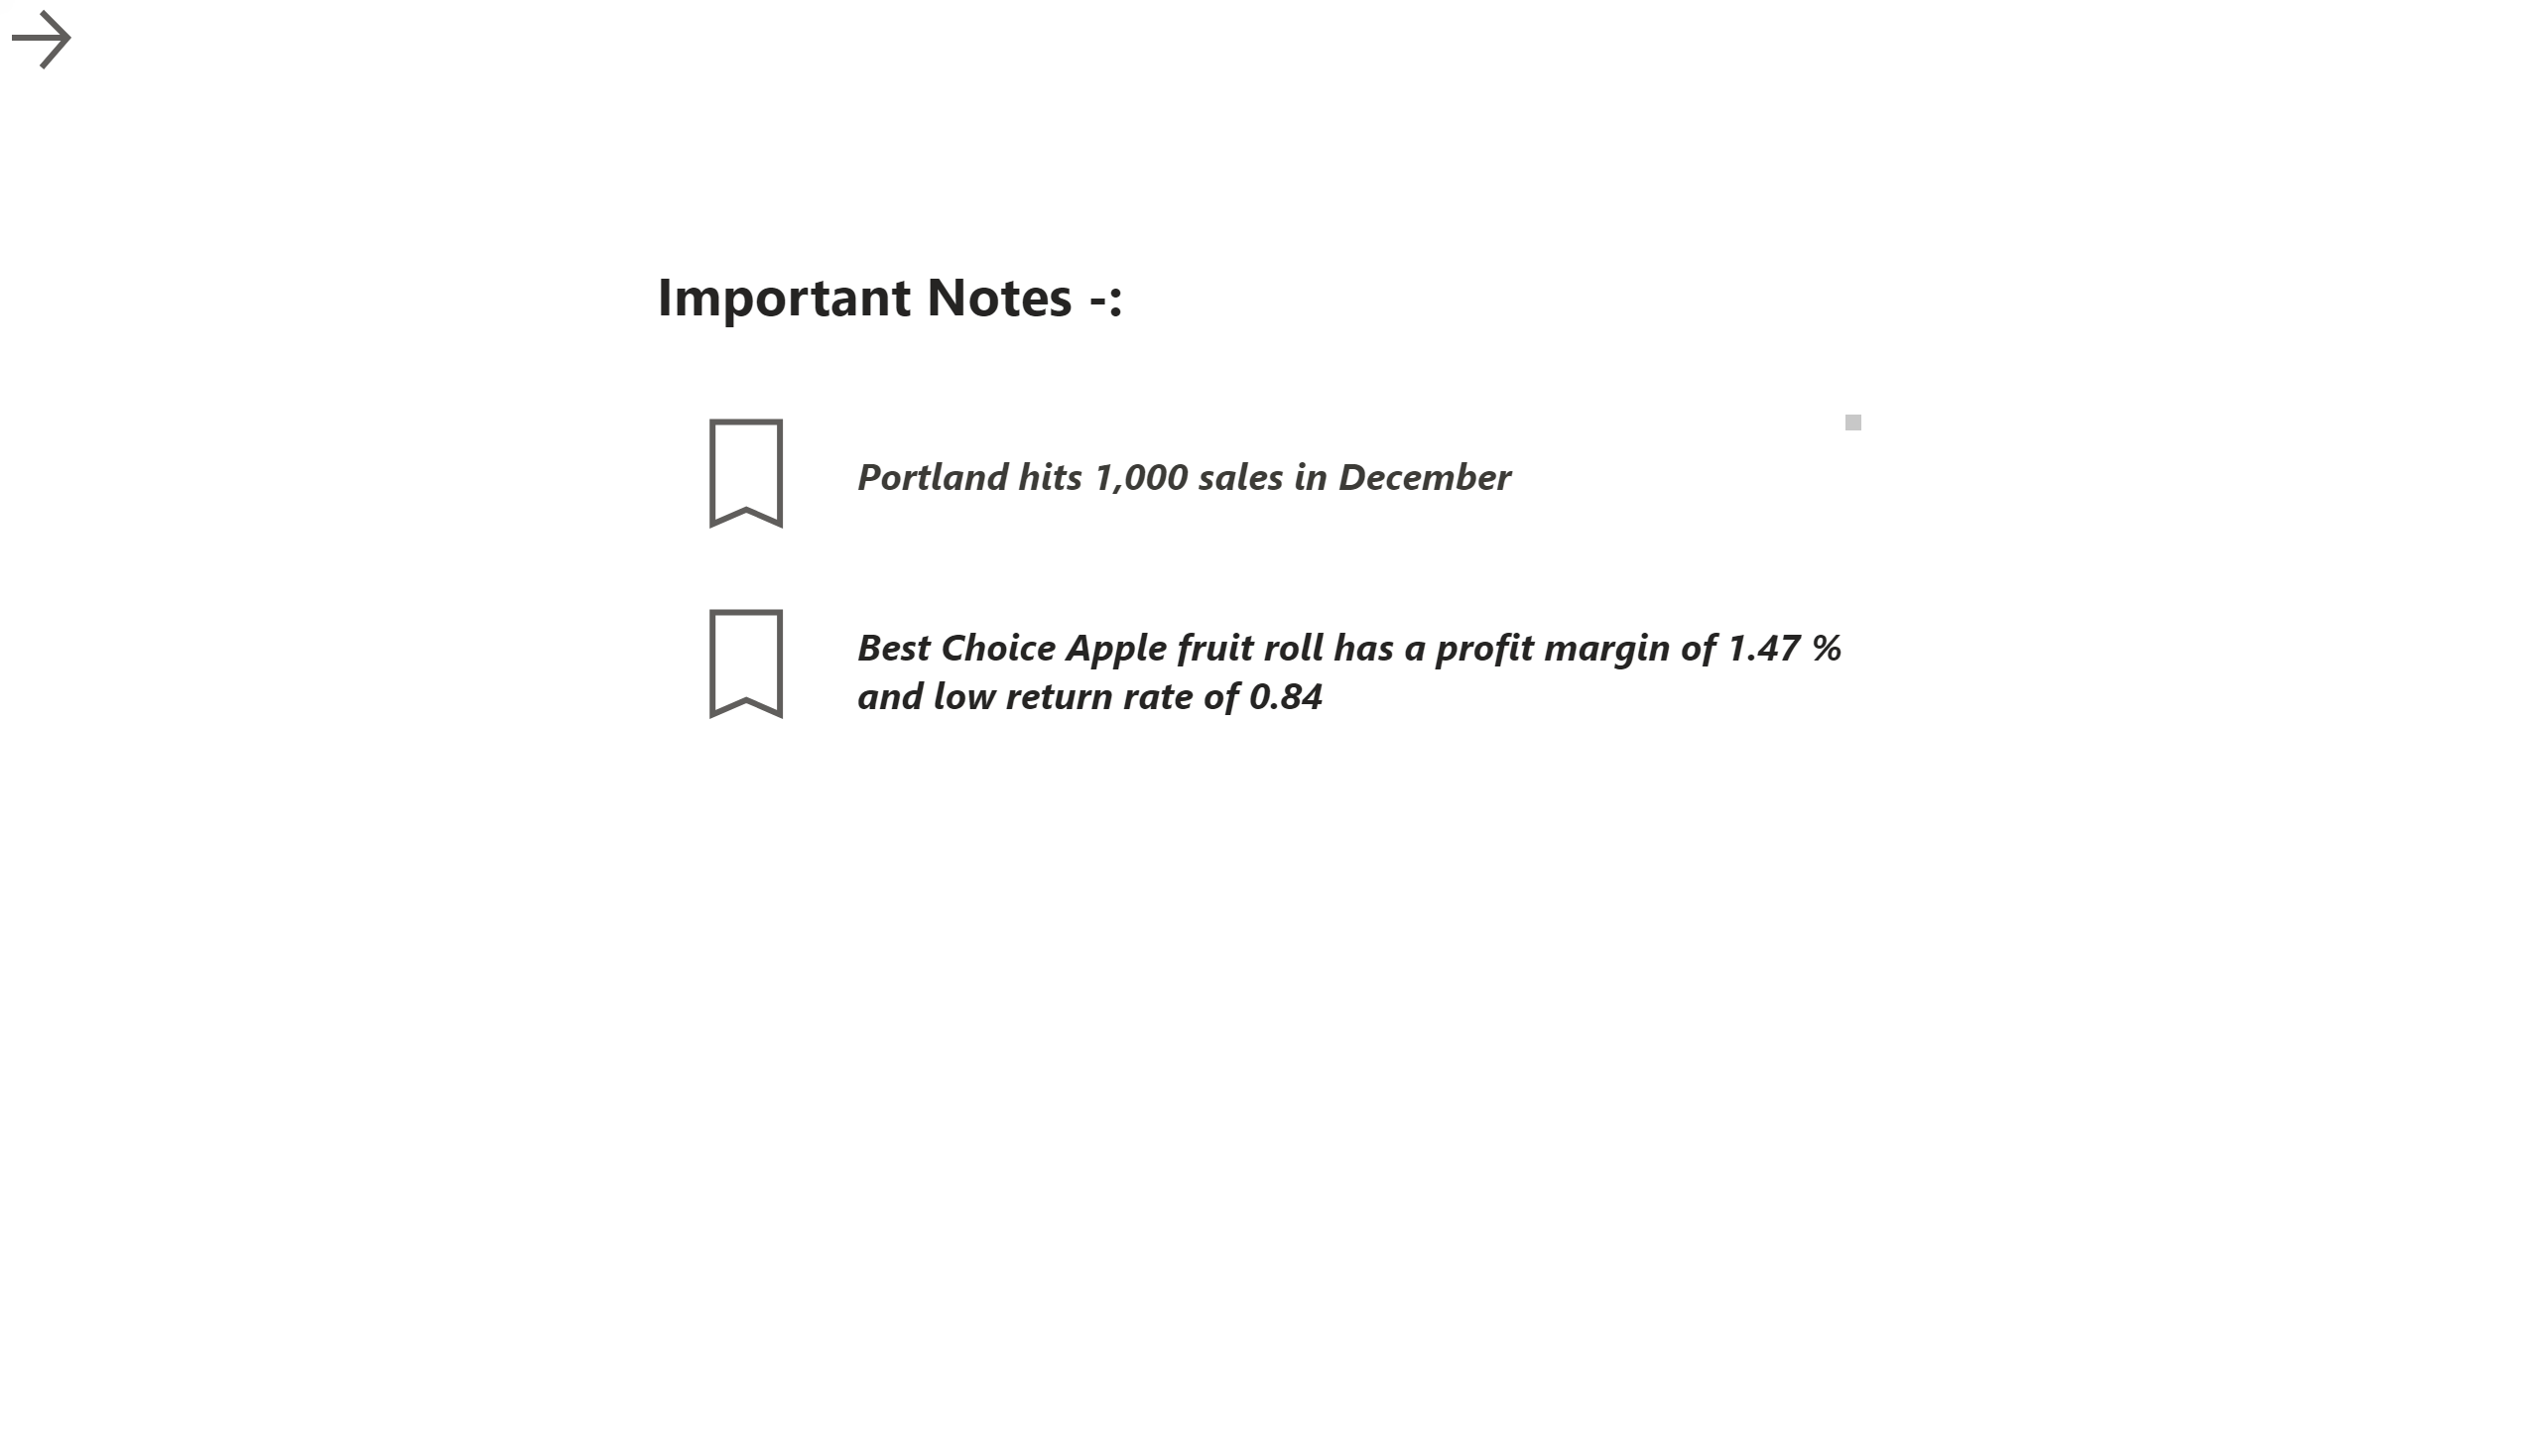
Notes
Notes:
textbox
No alt text provided.
textbox
No alt text provided.
textbox
No alt text provided.
actionButton
No alt text provided.
actionButton
No alt text provided.
actionButton
No alt text provided.
textbox
No alt text provided.

